Slide 1

Life Expectancy
Statistical Analysis
Group 3 – Nooshin & Helen

Slide 2

Which factor should a country give importance
in order to improve
the life expectancy of its population?

Slide 3


Contents
Data Collection
Analysis
Findings

Slide 4
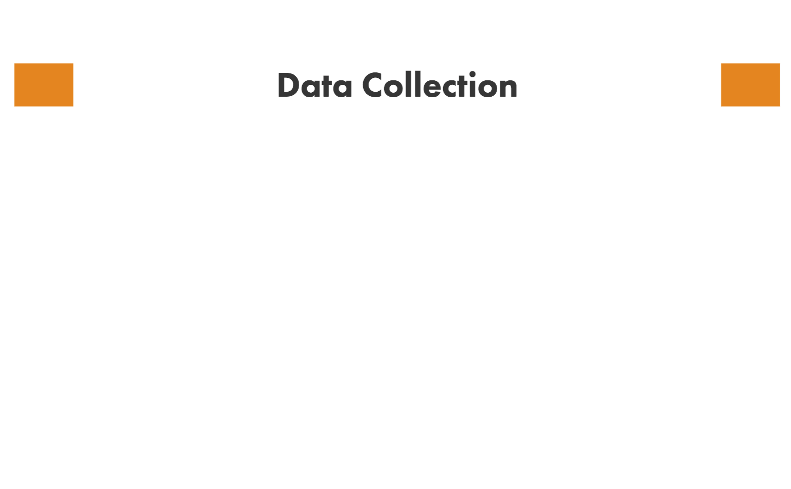
Life expectancy dataset from Kaggle website
https://www.kaggle.com/kumarajarshi/life-expectancy-who/version/1
193
16
2,938
x
Countries
Years 2000-2015

Slide 5
Life expectancy dataset from Kaggle website
https://www.kaggle.com/kumarajarshi/life-expectancy-who/version/1
2,938
1289
1,649
-
Missing values
Observations

Slide 6
1,649
Random sampling
75%
25%
Training Data
Test Data

Slide 7
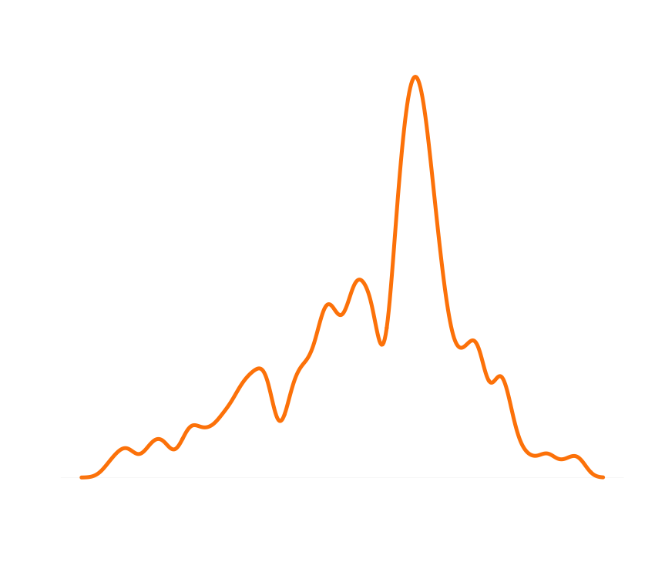
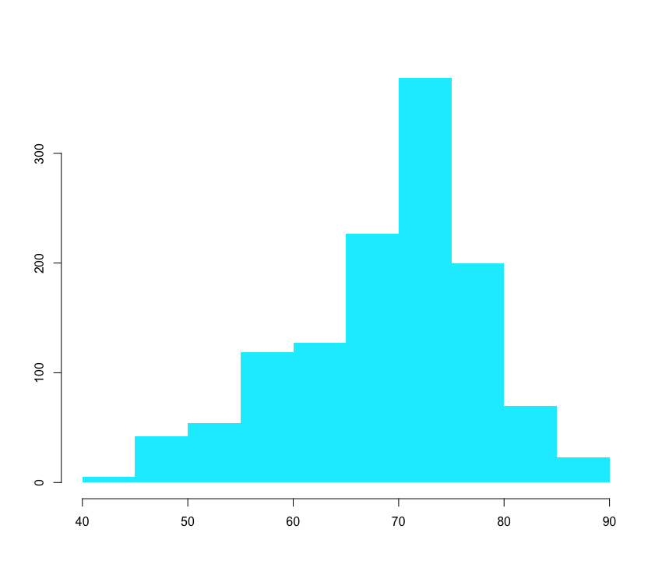
Response variable: Life Expectancy
Fairly normal
Mean: 69.25
Min: 44
Max: 89

Slide 8
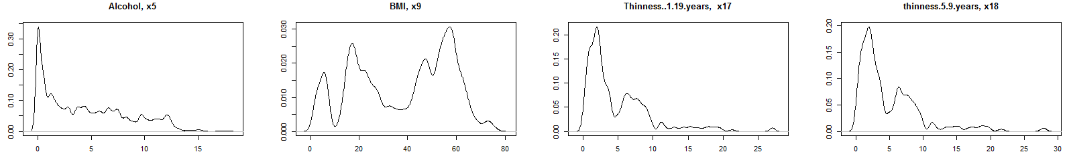
20 predictors: health, economic, immunization, mortality and social factors
Health factors
Alcohol consumed per capita (in liters)
Average BMI
Prevalence of thinness for Age 10-19
Prevalence of thinness for Age 5-9

Slide 9
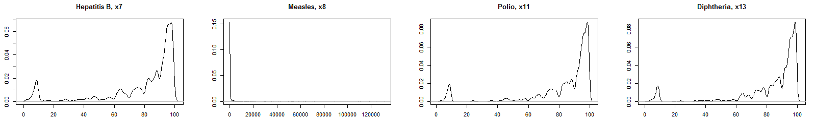
Immunization factors
% of immunization coverage
among 1-year-olds
# cases per 1000
% of immunization coverage
among 1-year-olds
% of immunization coverage
among 1-year-olds

Slide 10
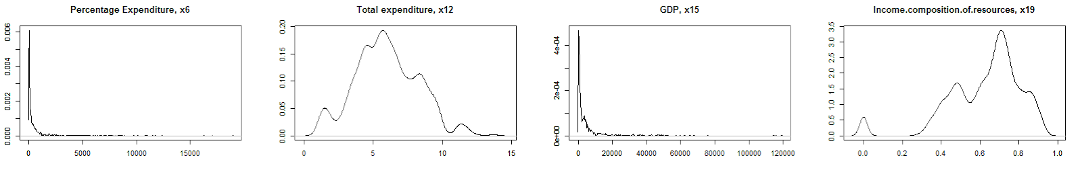
Economic factors
% expenditure on health of GDP per capita
% government expenditure on health
GDP per capita
Index 0-1 in terms of income of resources composition of resources

Slide 11
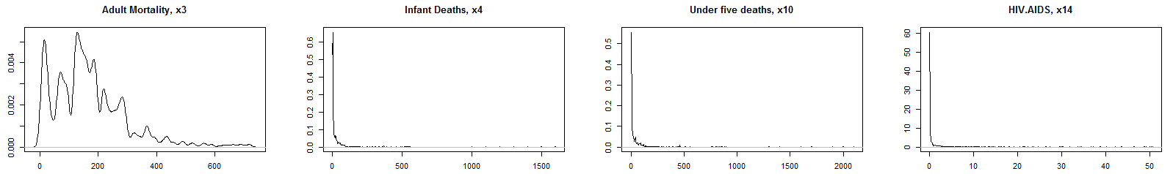
Mortality factors
Probability of dying between 15 and 60 years per 1000 population
# Infant deaths per 1000
# under-five deaths per 1000
Deaths per 1000 live births HIV/AIDS

Slide 12
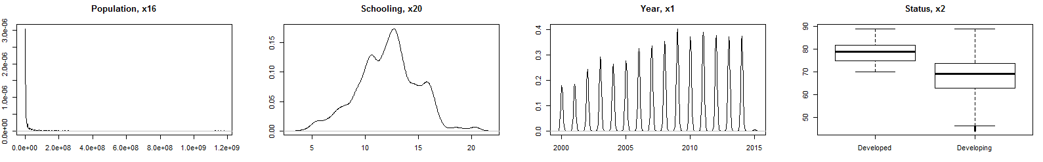
Social factors
Other factors
# of years of schooling
Developed or developing country

Slide 13
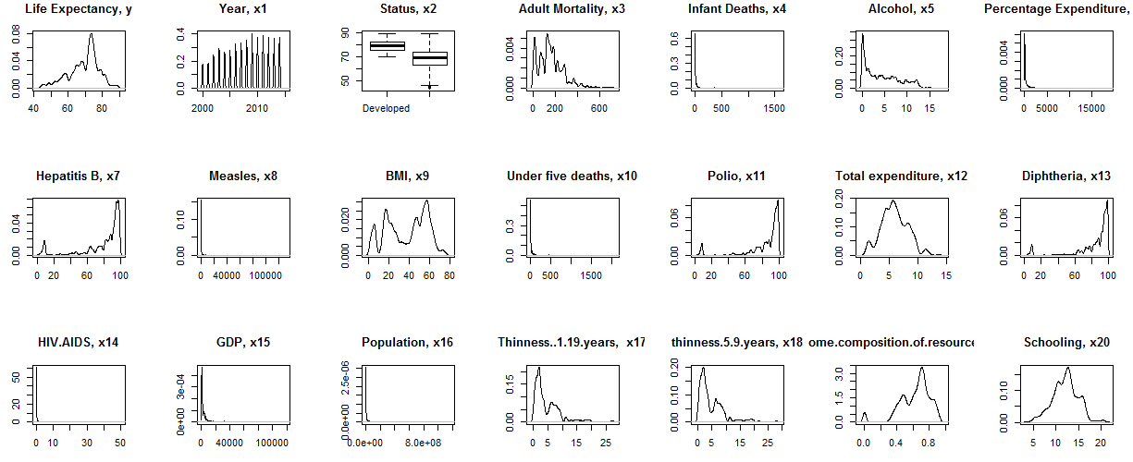

Slide 14

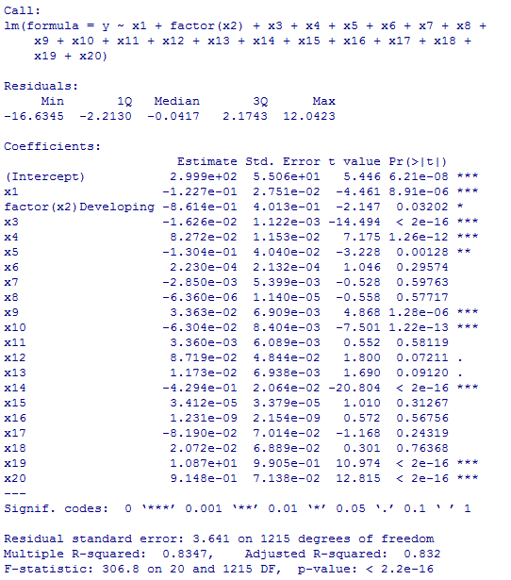

Slide 15
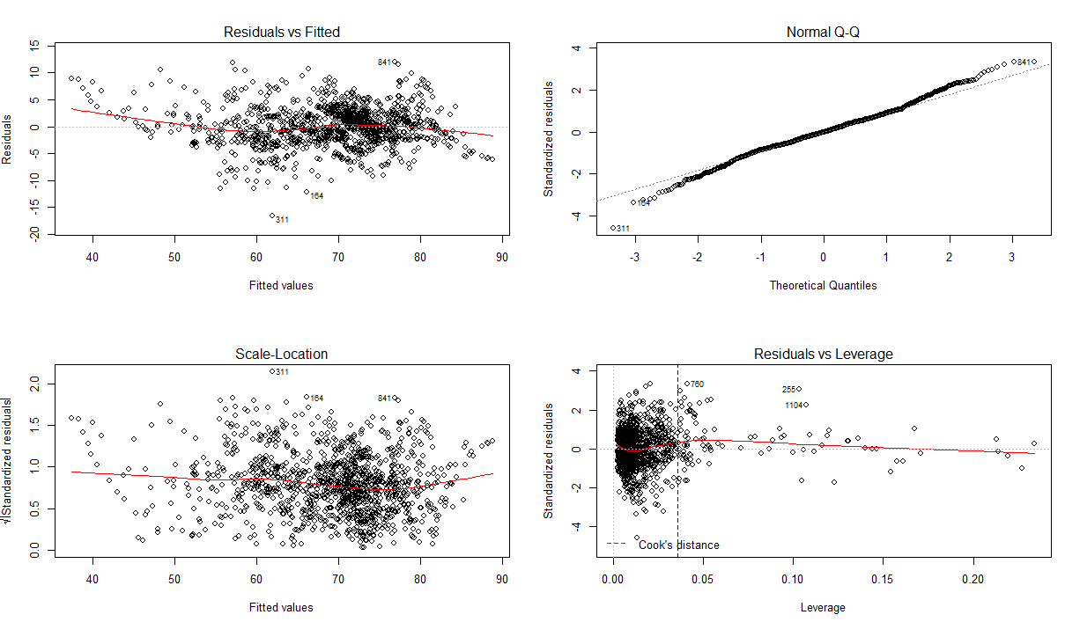

Slide 16
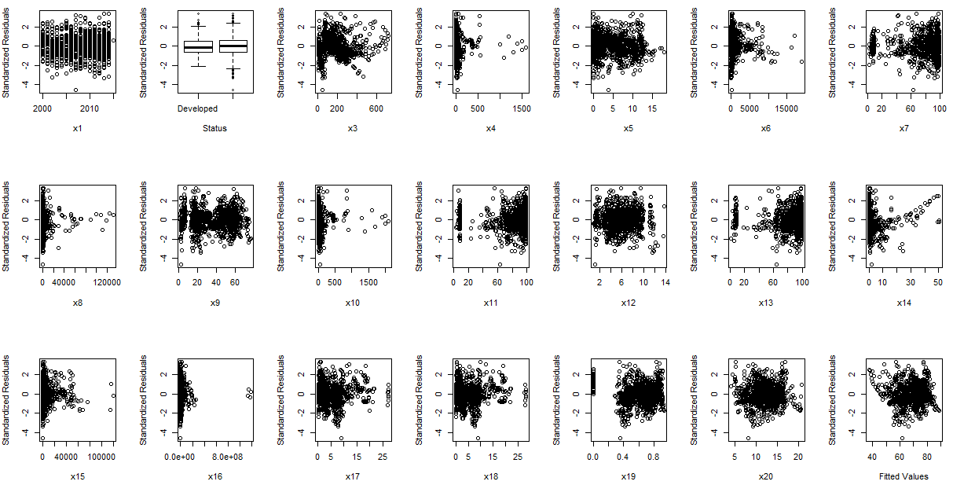

Slide 17
10 out of 20 predictors are insignificant
11 variables do not show the random scatter patterns in plots of standardized residuals against predictor.
Best Subset

Slide 18
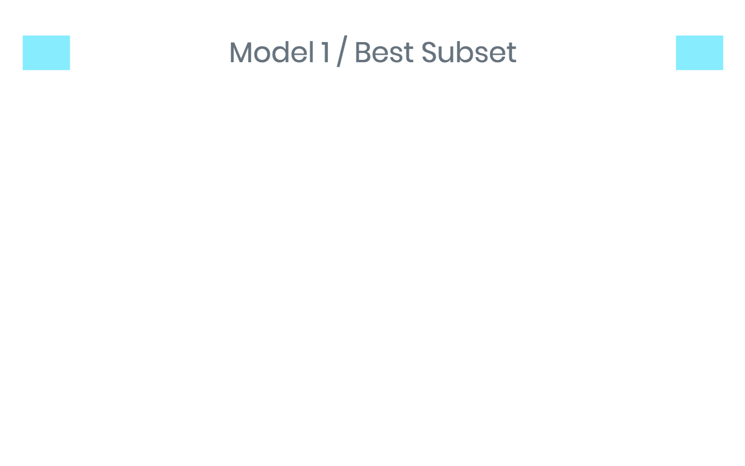
Size | Predictors | Adjusted R-squared | AIC | AICc | BIC
1 | x20 | 0.5364 | 4451.051 | 4,451.060 | 4,461.290
2 | x14, x20 | 0.7263 | 3800.621 | 3,800.641 | 3,815.980
3 | x3, x14, x20 | 0.7824 | 3518.318 | 3,518.351 | 3,538.797
4 | x3, x14, x19, x20 | 0.8049 | 3384.114 | 3,384.163 | 3,409.712
5 | x3, x9, x14, x19, x20 | 0.8110 | 3345.722 | 3,345.791 | 3,376.440
6 | x3, x4, x10, x14, x19, x20 | 0.8172 | 3305.408 | 3,305.499 | 3,341.245
7 | x3, x4, x6, x10, x14, x19, x20 | 0.8231 | 3265.85 | 3,265.968 | 3,306.807
8 | x3, x4, x6, x9, x10, x14, x19, x20 | 0.8281 | 3231.72 | 3,231.867 | 3,277.797

Slide 19
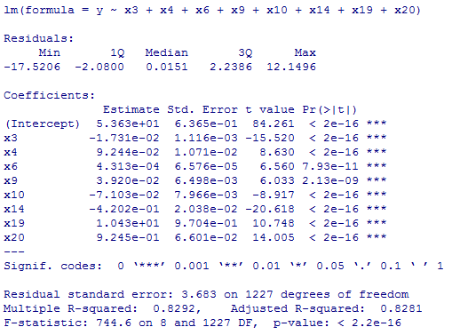
Adult Mortality
Infant Deaths
Percentage Expenditure
BMI
Under five Deaths
HIV/AIDS
Income
Schooling

Slide 20
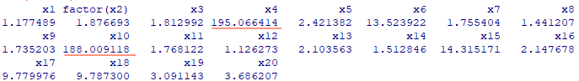
Check multicollinearity using VIF
Remove x4

Slide 21
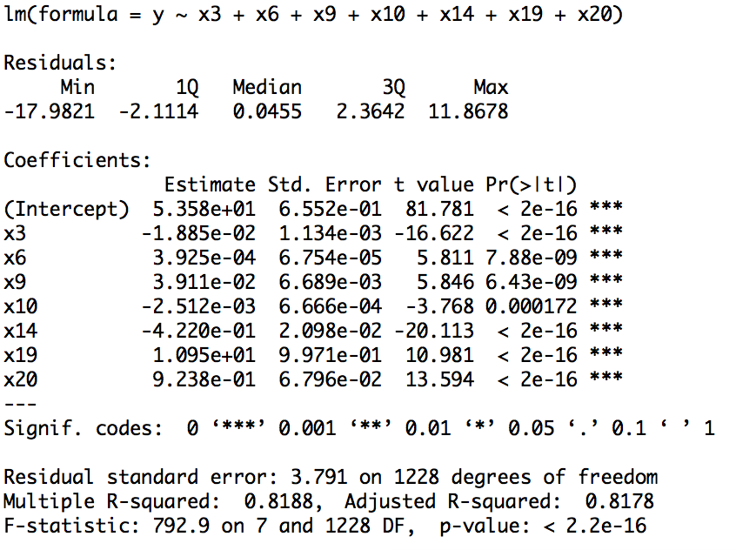
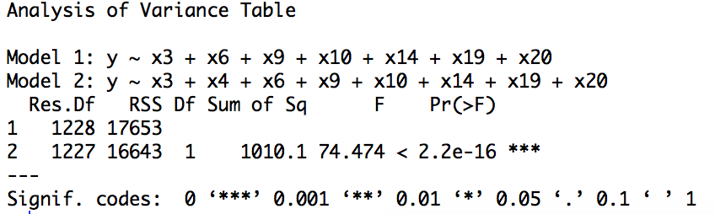
Adult Mortality
Percentage Expenditure
BMI
Under five Deaths
HIV/AIDS
Income
Schooling

Slide 22
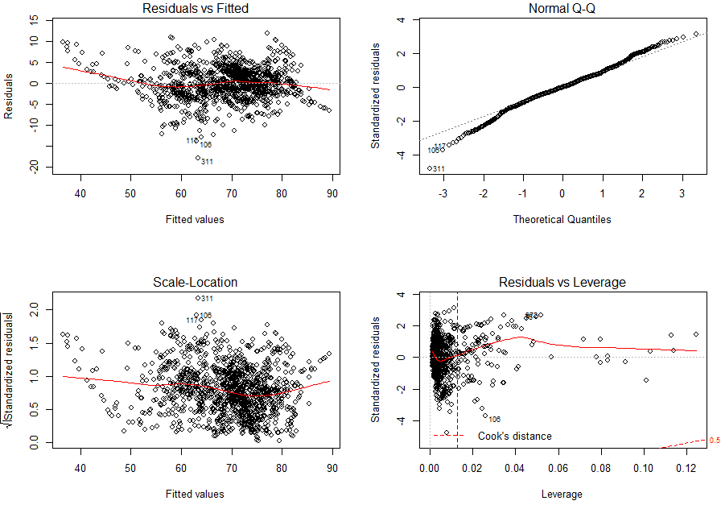

Slide 23
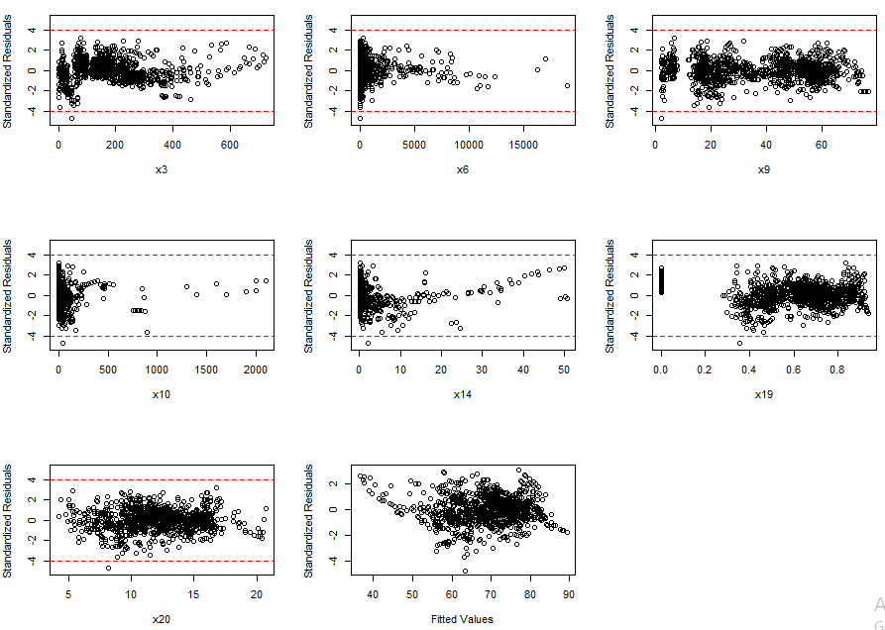

Slide 24
Life expectancy = 53.58 - .019 (Adult Mortality) + .0004 (Percentage
Expenditure) + .039 (BMI) - .003 (Under five Deaths) - .422 (HIV/AIDS)
+ 10.95 (Income composition of resource) + .924 (Schooling)
Adult mortality, Under five deaths, and HIV/AIDS have negative impact on Life Expectancy
Percentage Expenditure, BMI, Income composition, and Schooling have positive effect
Income Composition has the largest effect on the Life Expectancy
HIV/AIDS has the largest negative effect on life expectancy

Slide 25

Remove x4 due to high correlation with x10
Best subset
Size | Predictors | Adjusted R-squared | AIC | AICc | BIC
1 | x20 | 0.5364 | 4451.051 | 4451.07 | 4461.29
2 | x14, x20 | 0.7263 | 3800.621 | 3800.654 | 3815.98
3 | x3, x14, x20 | 0.7824 | 3518.318 | 3518.367 | 3538.797
4 | x3, x14, x19, x20 | 0.8049 | 3384.114 | 3384.182 | 3409.712
5 | x3, x9, x14, x19, x20 | 0.811 | 3345.722 | 3345.813 | 3376.44
6 | x1, x3, x9, x14, x19, x20 | 0.8159 | 3314.762 | 3314.879 | 3350.599
7 | x1, x3, x9, x14, x15, x19, x20 | 0.8185 | 3297.588 | 3297.735 | 3338.545
8 | x1, x3, x5, x6, x9, x14, x19, x20 | 0.8208 | 3282.996 | 3283.176 | 3329.073

Slide 26
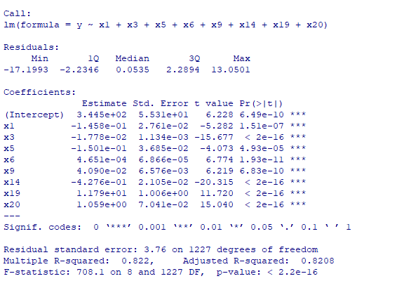
Year
Adult Mortality
Alcohol
Percentage Expenditure
BMI
HIV/AIDS
Income
Schooling

Slide 27
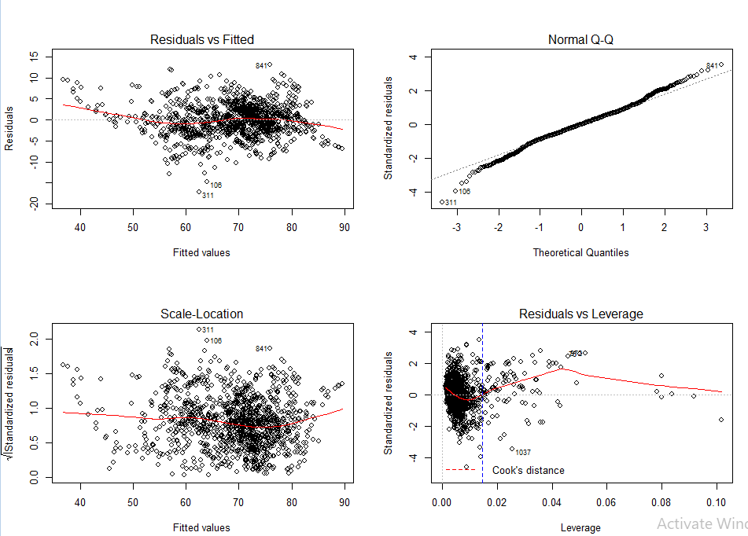

Slide 28
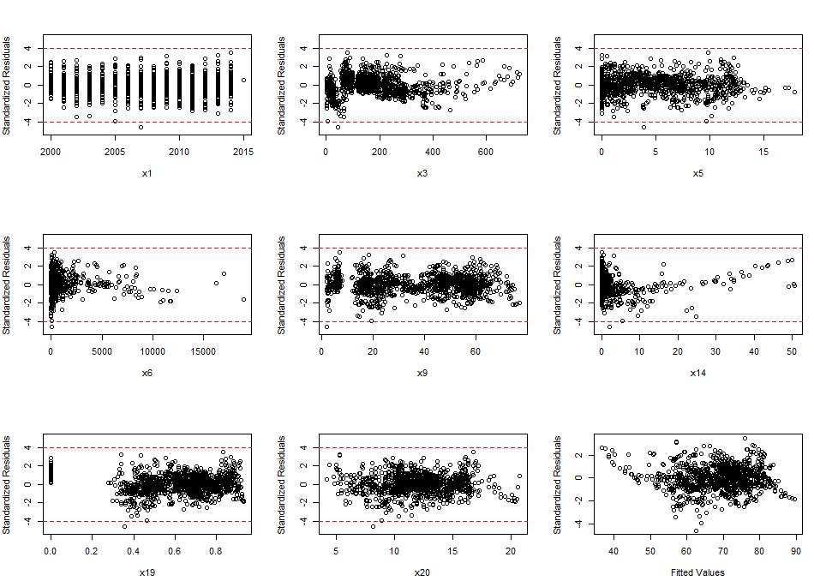

Slide 29
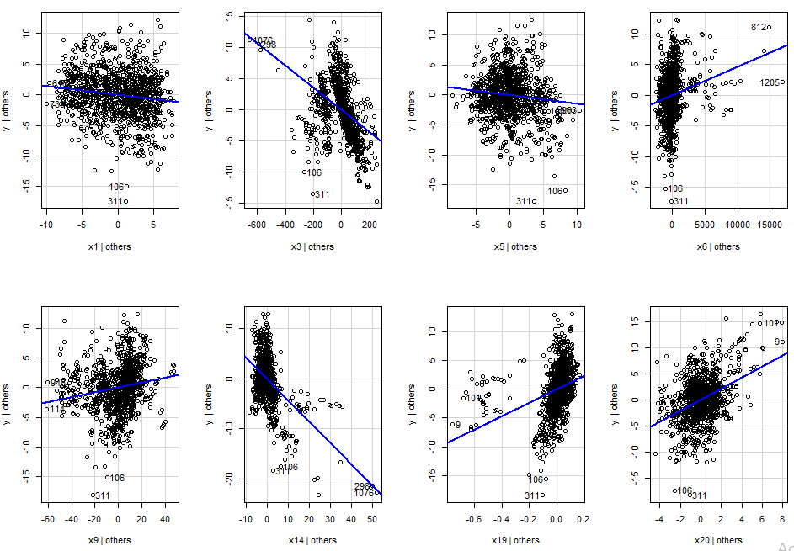

Slide 30
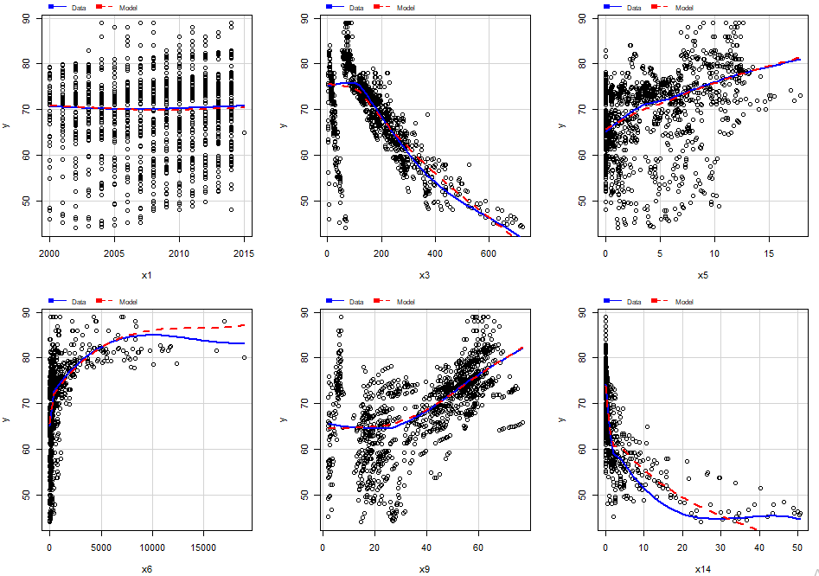
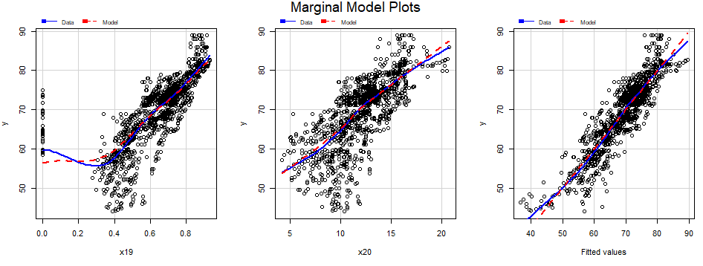

Slide 31
Life expectancy = 34.45 – .146 (Year) - .018 (Adult Mortality) -.15 (Alcohol) + .00004 (Percentage Expenditure) + .041 (BMI) - .428 (HIV/AIDS)
+ 11.79 (Income composition of resource) + 1.059 (Schooling)
Negative impact : Year, Adult mortality, Alcohol, and HIV/AIDS
Positive effect: Percentage Expenditure, BMI, Income composition, and Schooling
Life Expectancy increases by 11.79 years when Income Composition increases by 1 unit (other predictors are kept fixed)
Life Expectancy decreases by 0.4276 years when HIV/AIDS increases by 1 unit (other predictors are kept fixed)

Slide 32


Slide 33
Convert x4, x6, x8, x10 to categorical variables
0 | 24%
1-2 | 22%
3-30 | 35%
30-1600 | 20%
0 | 0.3%
0-100 | 45%
100-1000 | 41%
1000+ | 13%
0 | 21%
1-2 | 21%
3-30 | 33%
30-2100 | 25%
0 | 34%
1-10 | 14%
10-140K | 52%

Slide 34
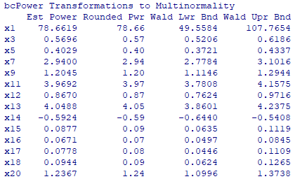
Box cox transformation
X3 = sqrt(x3)
X5 = sqrt(x5)
X7 = x7^3
X11 = x11^4
X13 = x13^4
X14 = 1/sqrt(x14)
X15 = log(x15)
X16 = log(x16)
X17 = log(x17)
X18 = log(x18)

Slide 35
Best Subset
Subset size | Predictors | Adjusted R-squared | AIC | Corrected AIC | BIC
1 | x20 | 0.5364 | 4451.051 | 4,451.060 | 4,461.290
2 | x14, x20 | 0.7263 | 3800.621 | 3,800.641 | 3,815.980
3 | x3, x14, x20 | 0.7824 | 3518.318 | 3,518.351 | 3,538.797
4 | x3, x14, x19, x20 | 0.8049 | 3384.114 | 3,384.163 | 3,409.712
5 | x3, x9, x14, x19, x20 | 0.8110 | 3345.722 | 3,345.791 | 3,376.440
6 | x3, x4, x10, x14, x19, x20 | 0.8172 | 3305.408 | 3,305.499 | 3,341.245
7 | x3, x4, x6, x10, x14, x19, x20 | 0.8231 | 3265.85 | 3,265.968 | 3,306.807
8 | X3, factor(x8), X13, X14, X15, X18, x19, x20 | 0.8281 | 3231.72 | 3,231.867 | 3,277.797

Slide 36
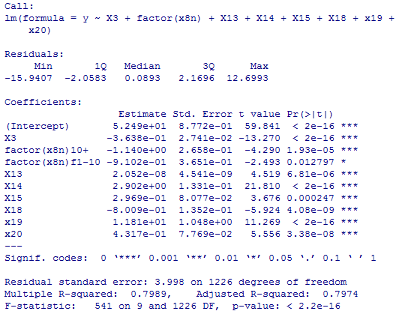
Adult Mortality / sqrt(x3)
Measles 10+
Measles 1-10
Diphtheria / x^4
HIV/AIDS / 1/sqrt(x14)
GDP / log(x15)
Thinness 5-9 years / log(x18)
Income
Schooling

Slide 37
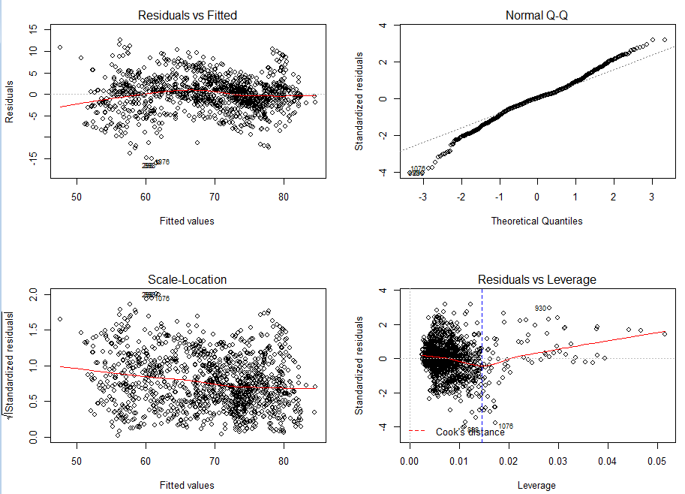

Slide 38
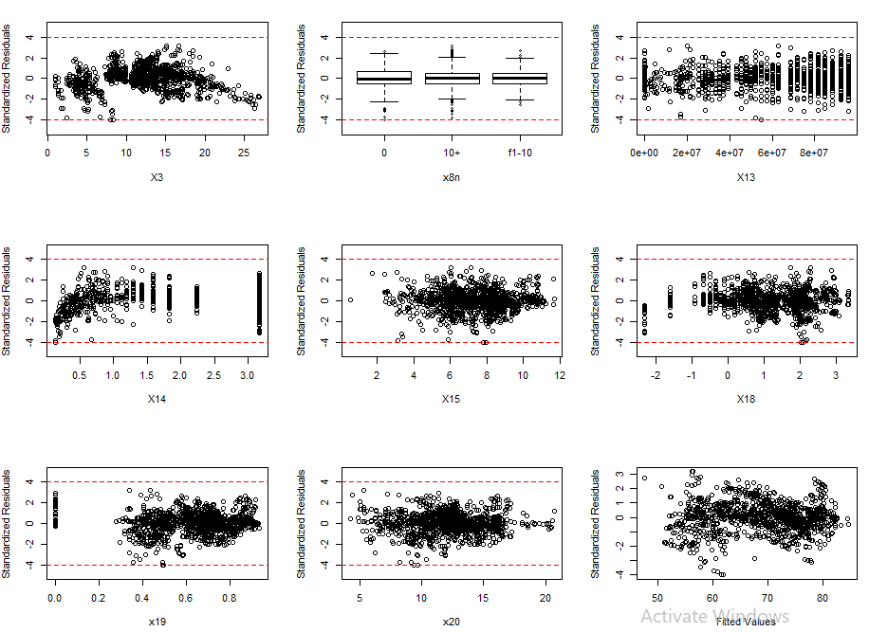
Fitted value

Slide 39

Remove x4 due to high correlation with x10
Box-cox transformation
X3 = sqrt(x3)
X5 = sqrt(x5)
X7 = x7^3
X11 = x11^4
X13 = x13^4
X14 = 1/sqrt(x14)
X15 = log(x15)
X16 = log(x16)
X17 = log(x17)
X18 = log(x18)
X6 = x6 ^.01
X8 = x8 ^.01

Slide 40
Best Subset
Subset size | Predictors | Adjusted R-squared | AIC | Corrected AIC | BIC
1 | X14 | 0.56527 | 4371.459 | 4371.479 | 4381.699
2 | X14, X19 | 0.7289 | 3788.639 | 3828.639 | 3803.998
3 | X3, X14, X19 | 0.76394 | 3618.698 | 3618.746 | 3639.176
4 | X3, X14, X19, X20 | 0.7810 | 3527.2 | 3527.269 | 3552.799
5 | X3, X10, X14, X19, X20 | 0.7892 | 3480.741 | 3480.832 | 3511.459
6 | X3, X10, X14, X18, X19, X20 | 0.79383 | 3454.336 | 3454.453 | 3490.174
7 | X3, X6, X10, X14, X18, X19, X20 | 0.7977 | 3431.751 | 3431.898 | 3472.709
8 | X3, X6, X10, X13, X14, X18, X19, X20 | 0.7999 | 3419.345 | 3419.525 | 3465.422

Slide 41
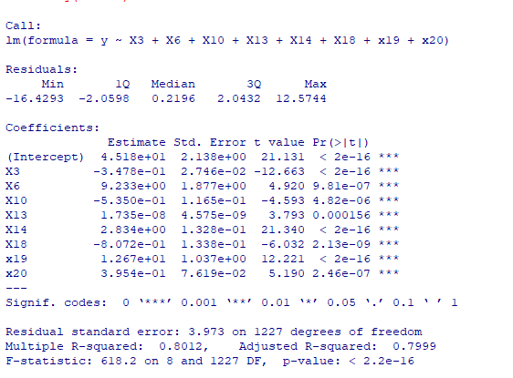
Adult Mortality / sqrt(x3)
Percentage Expenditure / x^0.01
Under five deaths / x^0.01
Diphtheria / x^4
HIV/AIDS / 1/sqrt(x14)
Thinness 5-9 years / log(x18)
Income composition
Schooling

Slide 42
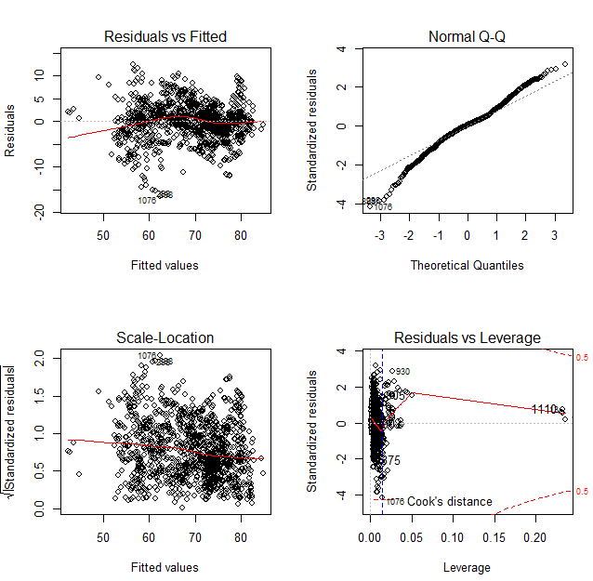

Slide 43
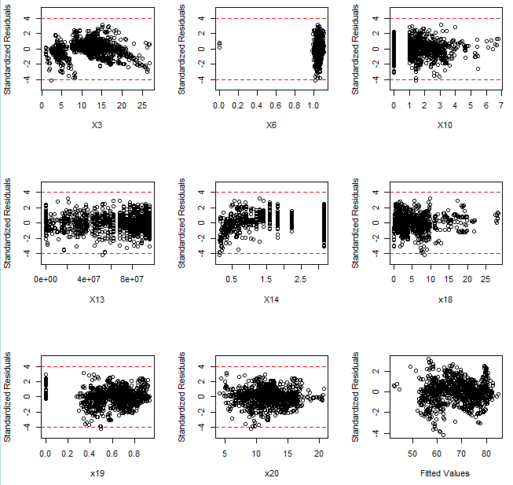

Slide 44
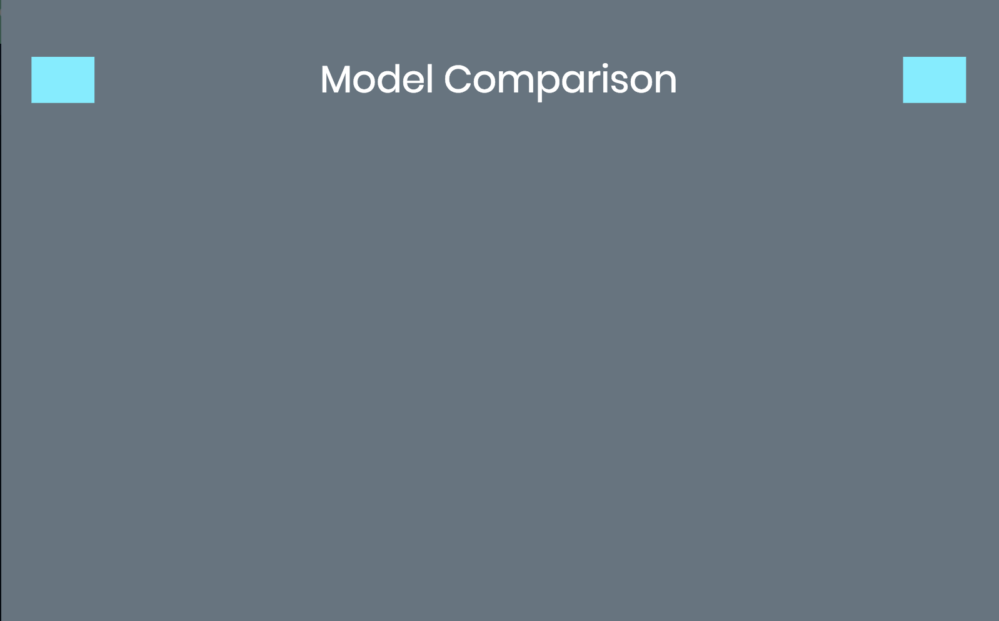

Model | Predictors | Adjusted R-squared | AIC | Corrected AIC | BIC | MAPE
1 | x3, x6, x9, x10, x14, x19, x20 | 0.8178 | 3,302.552 | 3,302.67 | 3,343.509 | 4.05%
2 | x1, x3, x5, x6, x9, x14, x19, x20 | 0.8208 | 3,282.996 | 3,283.143 | 3,329.073 | 4%
3 | X3, factor(x8n), X13, X14, X15, X18, x19, x20 | 0.7974 | 3,286.474 | 3,286.621 | 3,332.551 | 4.46%
4 | X3, X6, X10, X13, X14, X18, x19, x20 | 0.7999 | 3,419.345 | 3,419.525 | 3,465.422 | 4.4%
*MAPE = $( \frac{1}{n} \sum{\frac{|\hat{y}−y|}{y} )∗100\%}$

Slide 45

Life expectancy = 34.45 – .146 (Year) - .018 (Adult Mortality) -.15 (Alcohol) + .00004 (Percentage Expenditure) + .041 (BMI) - .428 (HIV/AIDS)
+ 11.79 (Income composition of resource) + 1.059 (Schooling)
Economic, Social, and Health Factors have the largest effect on Life Expectancy
A country having a lower Life Expectancy value should increase its health expenditure in order to improve its life span.
We can not say densely populated countries tend to have lower Life Expectancy since this predictor is not statistically significant.

Slide 46

Simon, J. (2009). A Modern Approach to Regression with R. New York, NY: Springer Science + Business Media, LLC
Rajarshi, K. (2018). Life Expectancy (WHO). Statistical Analysis on factors influencing Life Expectancy. Retrieved from https://www.kaggle.com/kumarajarshi/life-expectancy-who

Slide 47
Thank you!

